Slide 1
Alzheimer’s Disease:
Awareness,
Understanding,
Support and Care

Slide 2
Alzheimer's Request
Do not ask me to remember, don't try to make me understand.
Let me rest and know you're with me, kiss my cheek and hold my hand.
I'm confused beyond your concept, I'm sad and sick and lost.
All I know is that I need you to be with me at all cost.
Do not lose your patience with me, do not scold or curse or cry.
I can't help the way I'm acting, I can't be different though I try.
Just remember that I need you, that the best of me is gone.
Please don't fail to stand beside me, love me 'till my life is gone.

Slide 3
Alzheimer’s Disease - What is it?
- -
Alzheimer’s Disease –
Also called senile dementia - the most common cause of dementia among older adults
A progressive disease that destroys memory and other important mental functions, such as thought and speech
Causes 50 - 70% of all dementia
More than 5.4 million Americans are living with Alzheimer’s Disease
The 6th leading cause of death in the U.S.

Slide 4
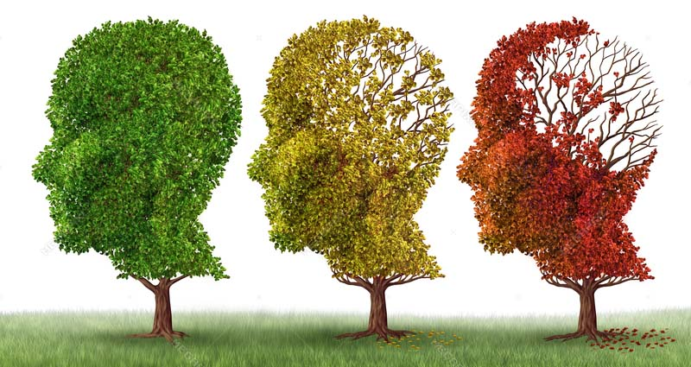
Dementia vs Alzheimer’s Disease
Dementia
An umbrella term for a set of symptoms including impaired thinking and memory
Associated with the cognitive decline of aging
Some forms of dementia, such as drug interaction or a vitamin deficiency, can be temporary or reversible
Alzheimer’s Disease
Degenerative and incurable at this time, not reversible

Slide 5
Alzheimer’s is one of the Largest Social, Medical, and Economic Crises in our Nation’s History
--
More than 5 million Americans live with Alzheimer’s, a disease that robs memories before taking lives
Begins to develop in the brain 20-30 years before diagnosis
2/3 of those diagnosed are women—and no one knows why
2/3 of Alzheimer’s caregivers are women, many of whom will have to take time off or resign from their jobs

Slide 6
Alzheimer’s is one of the Largest Social, Medical, and Economic Crises - Part 2
A woman in her 60’s - twice as likely to develop Alzheimer’s over the course of her lifetime than breast cancer
After 60 – a woman has a 1 in 6 chance of developing Alzheimer’s vs nearly 1 in 11 chance in a man
By 2050, 16 million in the US and 135 million worldwide will have fallen victim to this disease
Nearly half of Americans aren’t concerned about getting Alzheimer’s, because it doesn’t run in their families
Research proves that genes are not your destiny

Slide 7
Know the Facts – Alzheimer’s Disease
Not a natural part of aging
100% fatal - There is no treatment or cure
Progresses in stages from: Early Signs and Symptoms, to Mild Stage, to Moderate stage, and ending with Final Stage - which is severe and where the individual cannot communicate and is completely dependent on others for their care
Of the top 10 causes of death in America, the only disease without any effective treatment or cure
If Alzheimer’s runs in your family that does not necessarily mean you will get it
Conversely, if it does not run in your family, you are still at risk
Healthy habits, such as diet, exercise and lifestyle changes, can prevent or slow the symptoms

Slide 8
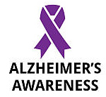
Know the Economics
Nation’s most expensive disease
Cost in US - $226 billion in medical treatment, caregiving costs, and lost wages of family members taking care of loved ones
Currently on track to bankrupt Medicaid
Federal funding for Alzheimer’s research is less than $1 billion a year, compared to $5 billion for cancer and $3 billion for HIV/AIDS
More funding for research is needed to find treatments and a cure for this disease
Expected cost of Alzheimer’s is projected to reach $1.1 trillion by 2050
Costs exceed other terminal illnesses, such as cancer and heart disease
Cost of care for a person with dementia over the last five years of their life is about $288,000

Slide 9
Alzheimer’s Treatment
No current cure
Certain cognitive enhancing medications can improve symptoms
Current Alzheimer's treatments cannot stop the disease from progressing
Treatments can temporarily slow the worsening of dementia symptoms and improve quality of life
Healthy habits can prevent or slow the symptoms
A Mediterranean diet, heavy in omega-3 fats, such as in salmon, trout, mackerel, seaweed and sardines, is a health way to treat and possibly prevent the disease and its progression

Slide 10
Alzheimer’s Prevention
According to the Weill Cornell Medicine’s Alzheimer’s Prevention Clinic, focusing on the emerging science of dementia risk assessment and prevention strategies, states that the goal is to assess threats and identify fixable issues known to affect brain health
Opportunity lies in modifying risk factors: what you eat, how you sleep, blood pressure, overall fitness, and even your waistline (abdominal fat raises your risk threefold)

Slide 11
Alzheimer’s Prevention (continued)
The more educated you are, the more information your brain stores and the better it accesses what you’ve learned
More educational experiences and new mentally stimulating activities add more connections and pathways in the brain, developing a “cognitive brain reserve”
If some pathways grow weak, the brain has extra paths to follow

Slide 12
Programs
The Women’s Alzheimer’s Movement
Founded by Maria Shriver
Committed to finding out why Alzheimer’s discriminates against women
Answering the question of why women are disproportionately affected by Alzheimer’s; may lead to a cure for all
www.thewomensalzheimersmovement.org

Slide 13
Model Program - Annunciation Senior Center
Mission - to create an environment stimulating the spiritual, social and interpersonal interaction of seniors in a loving, safe and comfortable environment through Orthodox based fellowship
Located in the Annunciation Orthodox Center, Baltimore, MD, the Senior Center team organizes and conducts a wonderful array of activities on a daily basis
Liturgical services, sacraments and religious events weekly
Contact Information Phone: (410) 752-3525 25 West Preston Street, Baltimore, MD 21201 Email: orthodoxseniorcenter@gmail.com Facebook Page:
facebook.com/AnnunciationSeniorCenter

Slide 14
Annunciation Senior Center
Daily Experience:
Activities designed to stimulate mind and body, promoting wellness and maintaining a happy and healthy life
Modest levels of physical activity intended to keep our seniors active
Healthy and balanced home cooked meals
Current events, dialogue in Greek and English
Word and board games
Guest speakers and performers
Field trips include museums, restaurants, festivals and other interesting events
Safe and reliable transportation

Slide 15
Caregivers
Over 15.9 million family members and friends are providing over 18 billion hours of unpaid care to their loved ones with Alzheimer’s and other dementias
Significant emotional, physical, and financial cost to everyone involved

Slide 16
Caregiving
Most Americans don’t know what the disease entails, who it impacts, or how to prepare for long-term caregiving.
Sixty-six percent of Americans want a family member to be their primary caregiver
More than half haven’t even talked to their families about it, having no idea what it will cost or involve
Only 1 in 4 seniors have had the conversation with their children
Only 1 in 3 millennials have talked with their parents about the issue

Slide 17
Information that Family Members Need to Know
Know the Person’s Legal and Financial Matters
To whom do they owe money or who may owe money to them
Computer passwords
Bank accounts, passwords, and safety deposit box info
Credit cards and PIN numbers
Stocks, bonds, investment or annuity accounts
Real estate
Insurance policies
Legal papers including: Power of Attorney, Health Care Power of Attorney, Current Will
Names and contact information of their Attorney, Accountant, Physicians, Companies or help they use

Slide 18
Five Wishes
MY WISH FOR:
The Person I Want to Make Care Decisions for Me When I Can’t
The Kind of Medical Treatment I Want or Don’t Want
How Comfortable I Want to Be
How I Want People to Treat Me
What I Want My Loved Ones to Know
Provided by the Greek Orthodox Archdiocese of America – Stewardship Ministries
Prepared by the Greek Orthodox Archdiocese of America with the support and cooperation of Aging With Dignity,
the nonprofit organization that created the Five Wishes living will

Slide 19
Being a Caregiver
Often a stressful and demanding ordeal
Have human needs and emotions
Must give themselves permission to be human
Must care for themselves as well as their loved one

Slide 20
Caregivers Have the Right to:
Be angry: Turn this energy into positive action. Clean a closet, take a walk, or talk with someone.
Be frustrated: Stop what you are doing, take a deep breath, and begin a different activity.
Take time out: Sit in a favorite chair in a quiet room, take a trip to the store, or spend a few hours out with friends.
Ask for help: Explore family, friends, and local agencies for resource services. Many doctors' offices and clergy provide referrals.
Recognize your limits: You are a valuable person. Take care of yourself, too!
Make mistakes: No one is perfect, and mistakes help you learn.
Grieve: It is normal to be sad over the loss of the way things used to be.
Laugh and love: Now more than ever, it's important to have meaningful connections.
Hope: Tomorrow, the day may go smoother, a friend may call, and new treatments may be found.

Slide 21
Resources – Alzheimer’s Association
The world's leading voluntary health organization in Alzheimer's care, support and research
Chapters across the nation, providing services within each community
Professionally staffed 24/7 Helpline (1.800.272.3900) which offers information and advice to callers in more than 170 languages

Slide 22
Hands on Programs or Projects
Philoptochos chapters can go on line and find the nearest Alzheimer's Association chapter and volunteer to help
Annual walkathons to raise money and awareness
June - Alzheimer's & Brain Awareness Month – Provide Handouts, Speakers, and Purple Ribbons
Volunteer at a local Alzheimer's Association Chapter for special events, helpline support, office help, and public education and awareness programs
Helping organizations, such the Alzheimer’s Association and the Bright Focus Foundation, is critical for funding Alzheimer’s research in the understanding, treatment, and cure for this disease

Slide 23
Alzheimer’s Communication
Never argue, instead agree Never reason, instead divert Never shame, instead distract Never lecture, instead reassure Never say "remember", instead reminisce Never say "I told you", instead repeat/regroup Never say "You can't", instead do what they can Never command/demand, instead ask/model

